Slide 1
LAr tests
From 03/07 to 07/07
Lucas

Slide 2
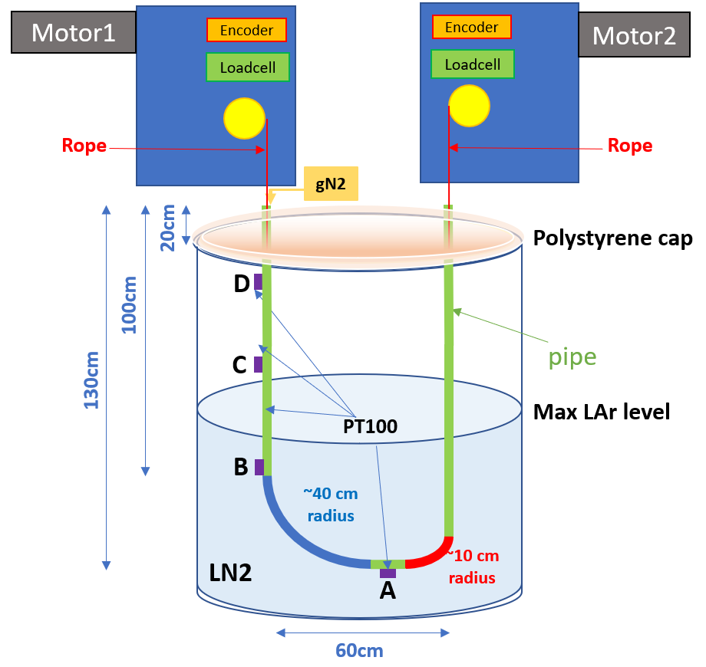
Summary :
Date | Hour | Ice Formation | °C | Tension before any test (N) | Voltage (V) | Current (A)
Mon – 03/07 | 13:35 | None | A,B at -183,95°C (LAr) C -145 D -68 | DS2 : 5 DS4 : 5 (relaxed) | DS2 : 24 DS4 : 24 | DS2 : 0.08 DS4 : 0.09
Tue – 04/07 | 10:50 | Intended | A, B LAr Temperature C -137.37 °C D -66,51°C | DS2 : 15 DS4 : 5 (not relaxed) | // | //
Wed – 05/07 | 14:21 | Intended | A, B LAr Temperature C -130.71 °C D -63,13 °C | DS2: 20 DS4: 5 (not relaxed) | // | //
Fri – 07/07 | 14:00 | Same | A,B LAr Temperature C -121.33 °C D -60,8 °C | DS2 : 25 DS4 : 7 (not relaxed) | // | //
+2 humidity sensors
DS4
(left)
DS2
(right)

Slide 3
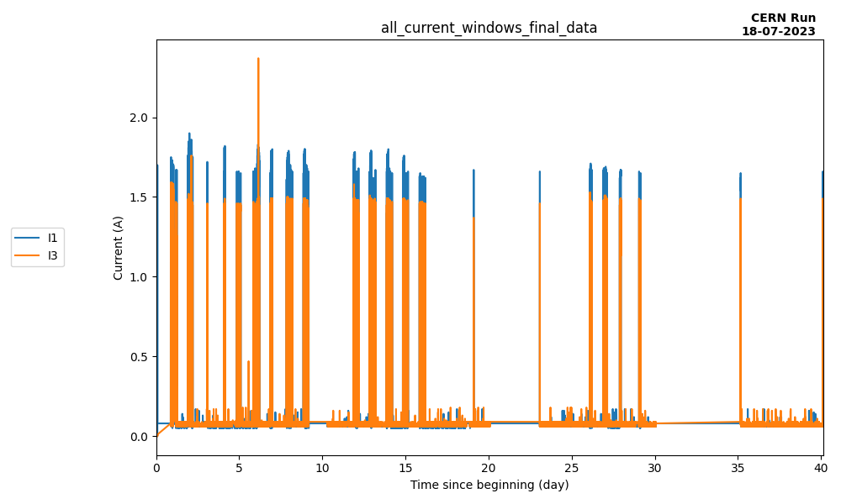
Current analysis
LN2 tests
LN2 → LAr
LAr tests
Motors used 3.9%
on 18 days
Motors used 0.9%
on 14 days
DS2
DS4
➔ Motors used ~4%
of the total time during LN2 tests

Slide 4
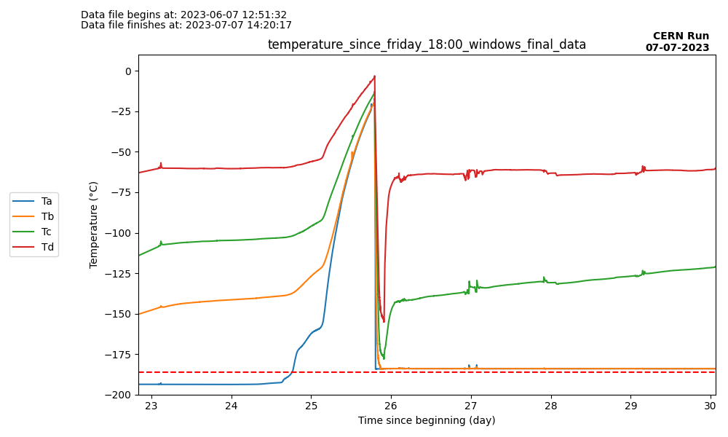
Temperature changes since Friday 30/06 at 9AM
Monday 26/06 : Start the heating process. Small heater placed in the tank.
Thursday 29/06 : Heating process accelerated : larger heater inside the tank, lid of the tank removed
Friday 30/06 : End of the active heating process, letting tank heat with ambient temperature.
Monday 03/07 : Filling of the cuve with LAr
Saturday
Sunday
Monday
Tuesday
Wednesday
Thursday
Friday
Friday 30/06 – 18h
LAr filling
LAr temperature

Slide 5
LAr in tank curve
Tank level decreasing linearly
(around 4%/day)

Slide 6
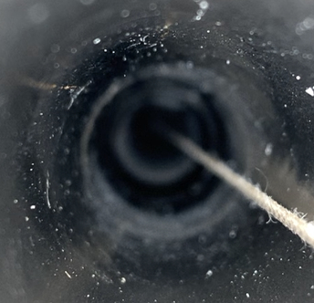

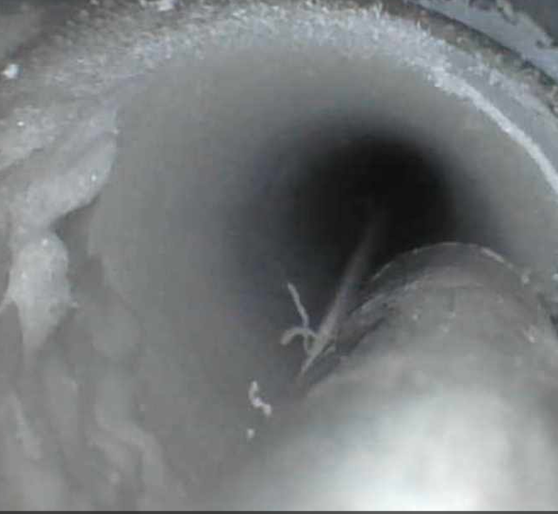
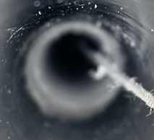
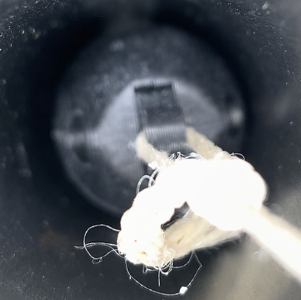
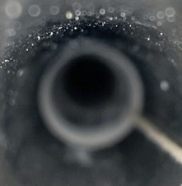
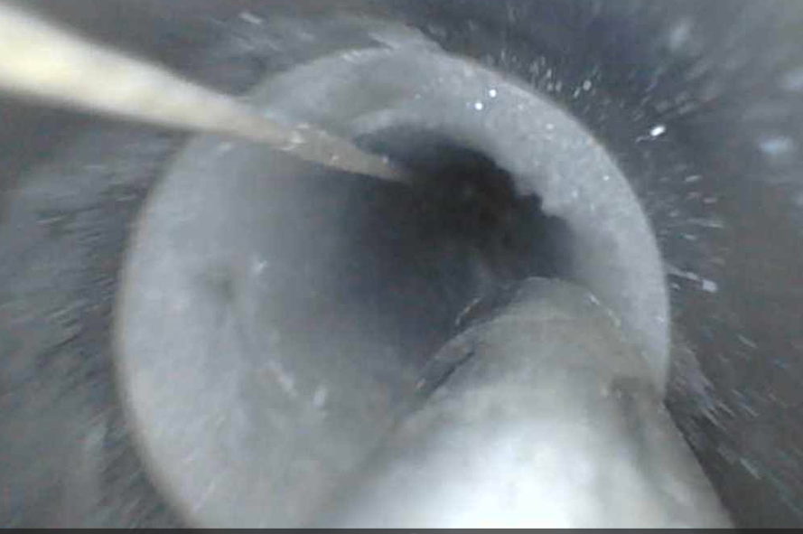
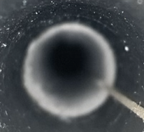
Flushing LN2 to see effect on ice :
Time | Monday 03/07 | Tuesday 04/07 | Wednesday 05/07 | Friday 07/07
Right Side (DS2)
Left Side (DS4)
T shaped gN2 pipe | NO | NO | NO | NO
gN2 Total flow | 60 L/h | 60L/h | 120L/h | 60L/h
LN2 in tube | None | None | None | None
%LN2 in tank* | 61% | 59% | 54% | ??
* No refill possible this time
Pictures are cropped to be visible so do not pay attention on sizes, more on shapes.

Slide 7
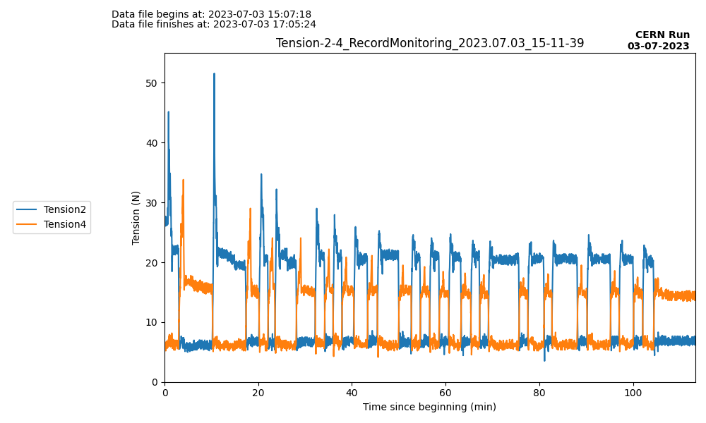
Tension during stress test 03/07
At beginning, tension very high → Reposition of the motors to be in straightly in front of the cap centers → Once again after adding humidity sensors
Tension value about same value as LN2 testing
➔ Tension value stable and comparable to LN2
Repositioning
of motors
Again repositioning
of motors
Avg DS2 tension
after repositioning
21N
Avg DS4 tension
after repositioning
15N

Slide 8
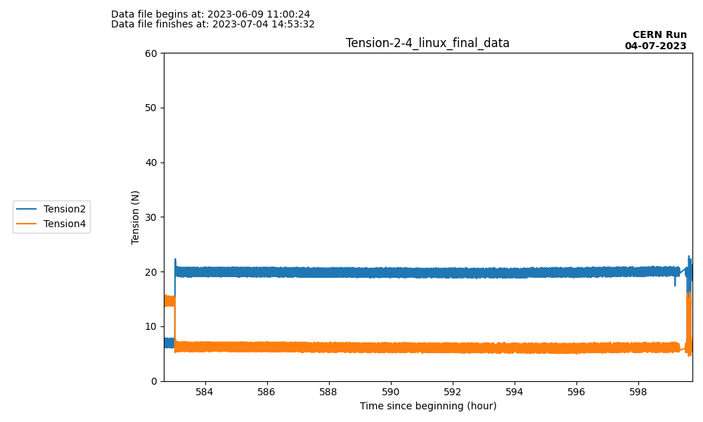
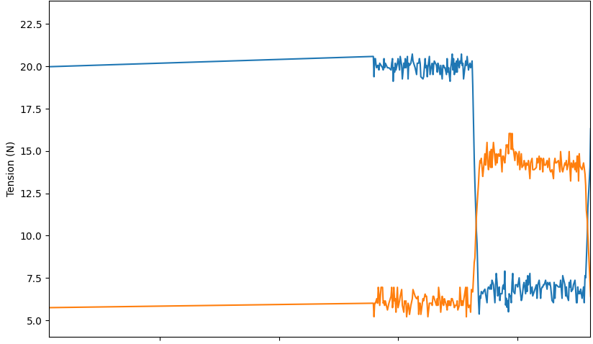
Long stay test (one night)
T=15N
Max tension 16N
T=15N
Source left at D for 16h, no high tension after moving it back to A (DS4)

Slide 9
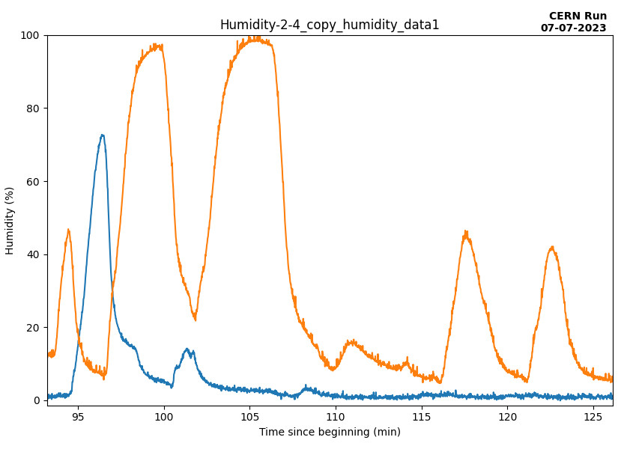
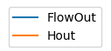
Humidity test 1/3
gN2 flow at 0L/h
gN2 flow at 30L/h
gN2 flow at 120L/h
gN2 flow at 60L/h
Regularly moving source from D to A to D, for different gN2 flow values
Left Humidity rising only if gN2 < 30L/h
Right humidity rise only if gN2 < 120L/h
No difference 0 and 30 L/h
Regular drop from 30L/h (80%) to 120L/h (~0%)
No humidity changes for gN2 flow at 120 L/h, no matter movement of pseudo-source.
DS4 (left)
DS2 (right)
D
D
D
D
D
D
D
A
A
A
A
A
A

Slide 10
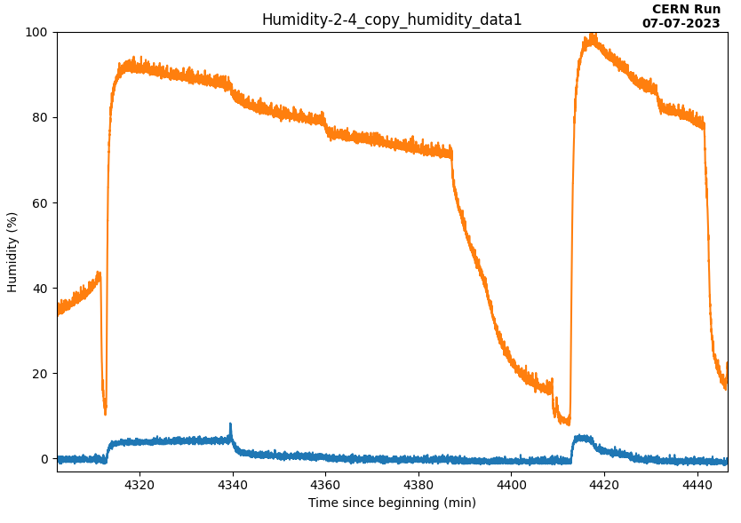
Humidity test 1/3 – Without moving source
30
60
120
0
30
60
120
0
120
gN2 flushing (L/h)
Vary gn2 flushing F and measure humidity when source at two positions : top-left (D), bottom (A)
Determine F which remove humidity “instantly” (<=10min) → F_{threshold}
Source Top-left : V_{before} small → 60 < F_{threshold} < 120 L/h ➔ Measure : F_{threshold} = 100L/h
Source Bottom: V_{before} larger → 120 < F_{threshold} < 250 L/h ➔ Measure : F_{threshold} = 150L/h
V_{before}(D)
4xV_{before}(D)
D
Source
D
C
C
B
B
Source
A
A
Reset Flushing 250L/h
DS4 (left)
DS2 (right)
➔ Assuming same scaling, F_{threshold} for DS20k with source at bottom might be around 300L/h
Source position at A
Source position at D

Slide 11
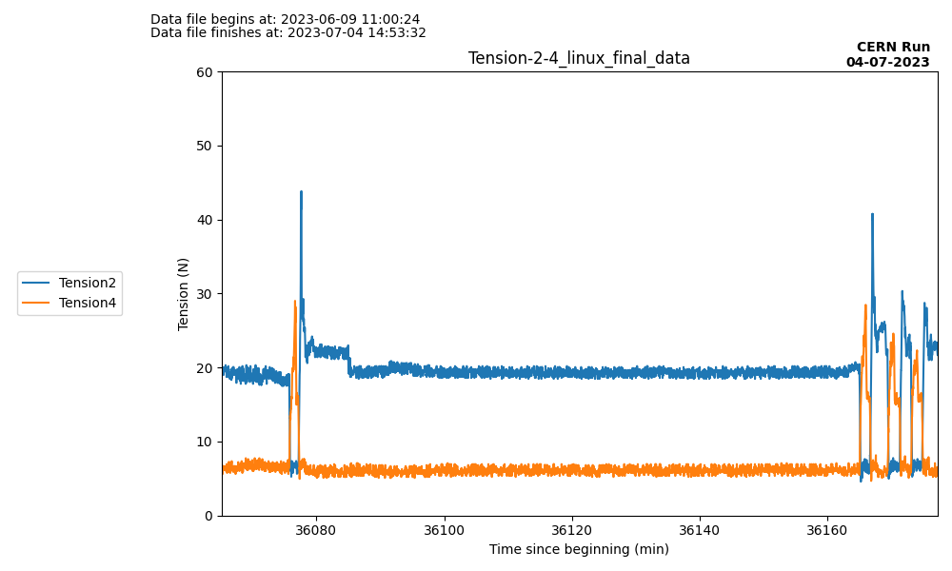
Humidity test 2/3
Humidity at 100%
Humidity at 0%
Pseudo-source in position A
Blow in tube from both sides to increase humidity at maximum and remove gN2 = Extreme nonrealistic scenario
After 5min, both humidity are at 100%
A→ D → A : +23N/+15N wrt normal
After 15min, put back the top caps and gN2 at 120L/h
After 1h30, both humidities at 0%
A→ D → A : +20N/+15N wrt normal but back to normal after 3 times
Avg DS2 tension in normal conditions
21N
Avg DS4 tension in normal conditions
15N
D
D
D
D
A
A
A
A
A
A

Slide 12
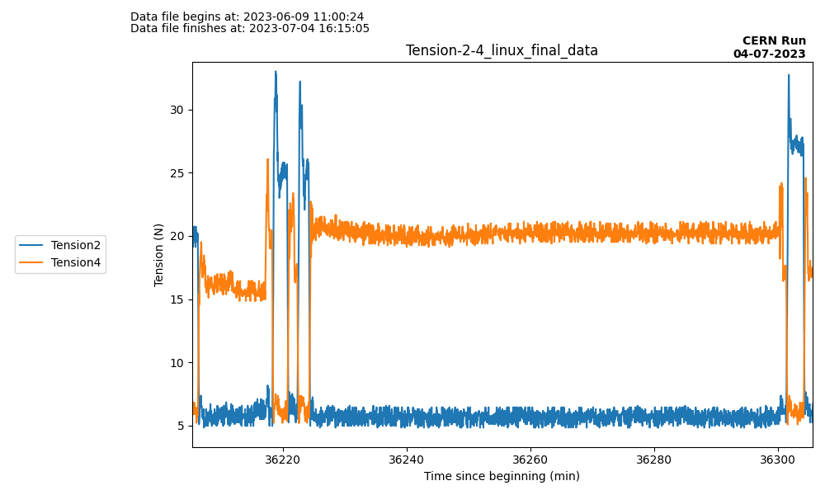
Humidity test 3/3
Humidity at 100%
Humidity at 0%
Pseudo-source in position B
Blow in tube from both sides to increase humidity at maximum and remove gN2 = Extreme nonrealistic scenario
After 5min, both humidity are at 100%
A→ D → A : +12N/+11N wrt normal
After 15min, put back the top caps and gN2 at 120L/h
After 1h30, both humidities at 0%
A→ HG* → CG* : +12N/+9N wrt normal
Avg DS2 tension in normal conditions
21N
Avg DS4 tension in normal conditions
15N
D
D
D
HG*
*HG : Hot Garage
*CG : Cold Garage
A
A
A
A
A
A
CG*

Slide 13
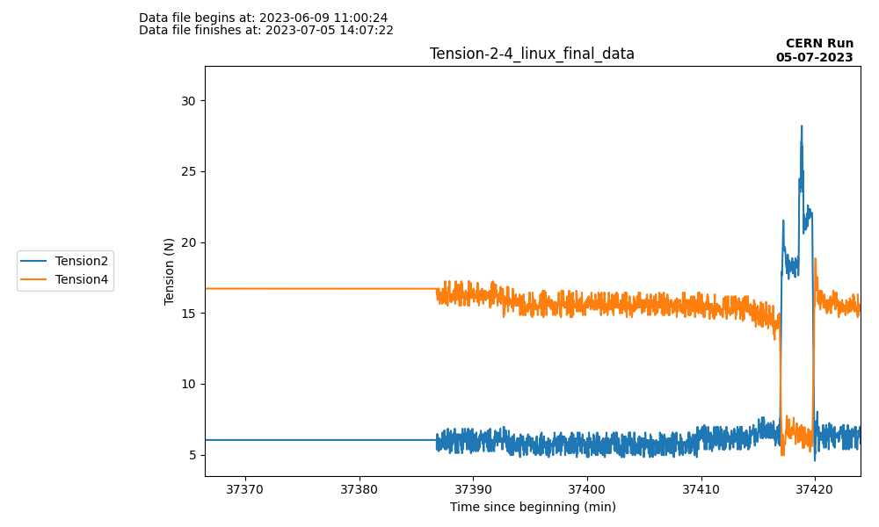
Humidity test 3/3 – After night
Pseudo-source in position Cold garage for 1 night
CG* → D → A : +8N/+5N wrt normal
Data from previous slide
18h before
Avg DS2 tension in normal conditions
21N
➔ With long-time flushing, maximum tension due to ice formation decreases
Avg DS4 tension in normal conditions
15N
D
*HG : Hot Garage
*CG : Cold Garage
CG*
A

Slide 14
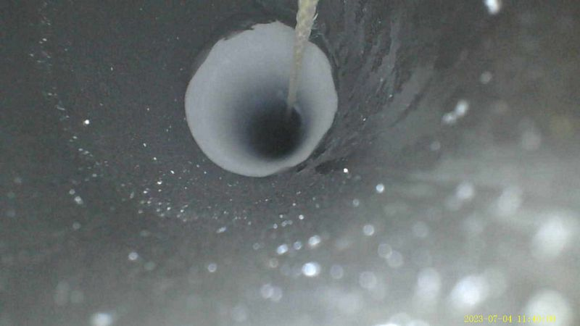
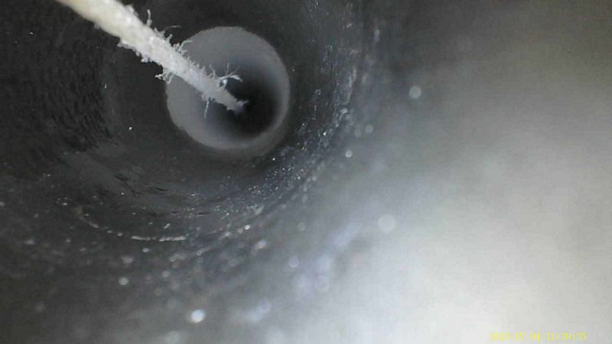
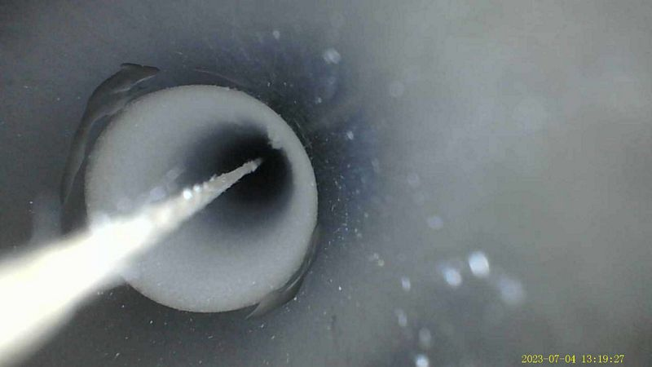
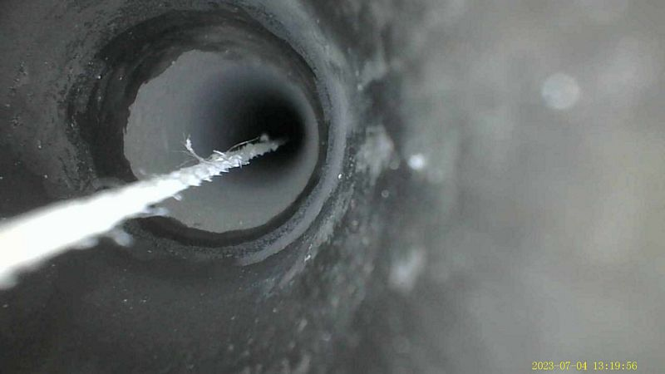
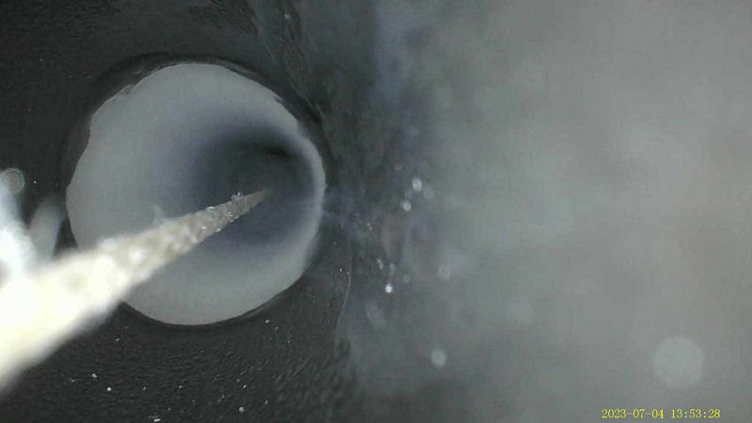
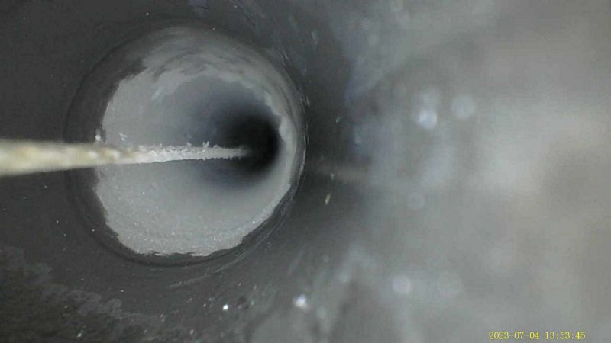
Endoscope pictures
DS4
DS2
After long blowing (100% humidity)
After 1h 15mn of gN2 @120 l/mn
After 2nd long blowing (100% humidity)

Slide 15
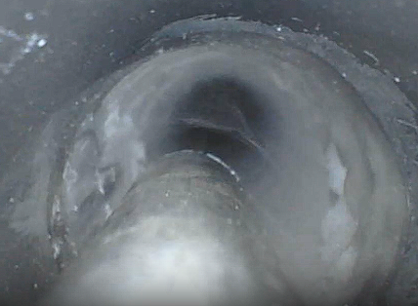
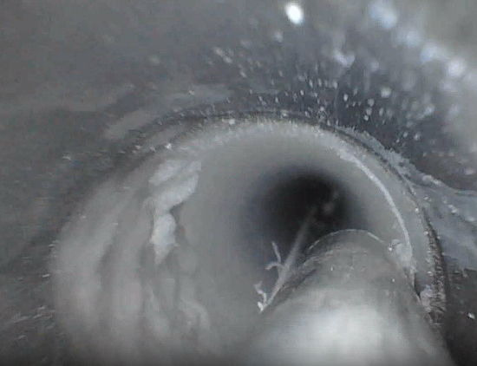
Ice/Frost identification DS2
Correct thickness
Illusion of thickness
due to camera
Frost pieces coming off
Soft frost removed with the stick
The top part is frost (~1mm thick)

Slide 16
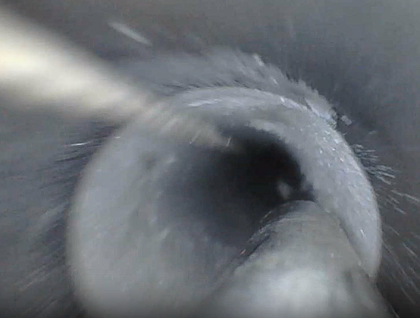
Ice/Frost identification DS4
Illusion of thickness
due to camera
Correct thickness
Frost pieces coming off
Frost pieces coming off
The top part is frost (~1mm thick)

